Slide 1
Macro programming
Business Intelligence Systems and Data Mining IMAT5168 Analytics Programming

Slide 2
Macros
Macros are a text substitution mechanism.
Analogy: text replacement in a document.
When a macro is defined
The definition is stored in a catalogue of definitions
& disappears from the code
When a macro is used
The ‘usage’ is replaced by the text in the macro body.
Each macro variable is replaced by the corresponding text.
The newly created code is then executed as if the macro had never existed.
Macros are a mechanism for the computer to write code.

Slide 3
Macro variables
%let var=week; /* Set variable var to week */
%let time=1; /* Set variable time to 1 */
%let heading=%str(This is a test!); /* Set variable heading to: 'This is a test!' */
title "&heading"; /* The contents of macro variable heading sets the title text */
/* Note:
use: " instead of ' to ensure &heading is converted to text
use: & to mean use macro variable: heading not the text: 'heading'
*/
title2 "&var.&time data"; /* Use var and time to set title2 */
/* Note: use: . to mark the end of macro variable var */
proc print data=TEST noobs;
var &var.&time; /* use: var and time to select the variable to print */
run;

Slide 4
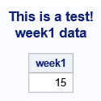
Macro variables
Applying the macro variables to these data…
…gives the output:
data test;
input
week1
weight1
week2
weight2;
datalines;
15 70 25 74
;
run;

Slide 5
Debugging Macros
Use these options:
symbolgen print macro symbols
mprint print macro code
mlogic print macro logic
Note:
Clear the log on each run.
The options can be switched off by preceding each option with no – e.g. nomprint

Slide 6
Example debugging output
The code…
The debug output
options symbolgen;
%let heading=%str(This is a test!);
title "&heading data";
%let var=week;
%let time=1;
title2 "&var.&time data";
SYMBOLGEN: Macro variable HEADING resolves to This is a test!
SYMBOLGEN: Some characters in the above value which were subject to macro quoting have been unquoted for printing.
title "&heading data";
SYMBOLGEN: Macro variable VAR resolves to week
SYMBOLGEN: Macro variable TIME resolves to 1
title2 "&var.&time data";

Slide 7
Portability – the problem
Problem
You have written a program to process raw data.
You need to run it in a different SAS environment with different data file locations and data file names and using different libraries.
Solution
Use text-substitution and references

Slide 8

Portability – useful components
Text substitution - macros
Macro variables
Define names that are replaced by text in a code file
File/Directory References
filename
a name for an OS file or directory for raw data files
libname
a name for an OS directory for all types of SAS files
options fmtsearch
a list of libraries in which to look for SAS format files
Include code
Include a SAS code file in another SAS code file

Slide 9
Explanation of SAS commands
%let V = W
defines a macro variable called V
&V is replaced by word W (text without spaces) whenever it appears in the code
%let V = %str(S)
%str defines a macro string literal to be sentence S (text with spaces)
Use "&V" to expand the macro string literal in a code text literal
SAS statements
filename name "directory";
names a directory containing any type of file
libname name "directory";
names a directory containing any type of SAS file
name can be used before any SAS output file to store it in a user defined location. (The default is: work.)
mytest.customer stores customer in the directory defined by mytest

Slide 10
Modularising code
There may be code that you want to re-use:
Example:
re-coding missing values
re-usable formats
Solution:
Create code libraries & use:
%include <filename>

Slide 11
Example Driver File
The included file should use data(&data_file) to refer to the raw data
%let data_dir = %str(c:\folder_name); /* set name of raw data directory */
%let data_file = %str(credit.txt); /* set name of raw data file */
filename data "&data_dir"; /* set reference to data file directory */
%let sas_data = customer; /* set name of SAS data file */
The included file should use &library to refer to the library where SAS files are to be stored
%let library = mytest; /* set name of user library */
libname &library "&data_dir"; /* set location of user library */
options fmtsearch=(&library); /* look for format files in this list */
The driver file should use libs(file.sas) to refer to the library where SAS code files are stored
%let code_dir = %str(c:\folder_name); /* set name of code directory */
filename libs "&code_dir"; /* set reference to code directory */
%include libs(read-credit.sas); /* include text of code file here */

Slide 12
Example Code File
/* read-credit.sas */
proc format
library = &library; /* resolves to library = mytest */
invalue purpose
/* code to define purpose informat */
;
run;
data &library..&sas_data; /* use required SAS data file */
/* NOTE:
* The first ‘.’ is used to mark the end of the macro variable library
* because the next character is a ‘.’
* Code resolves to: data mytest.customer;
*/
infile
data(&data_file) /* resolves to data(credit.txt) */
missover
;
/* use the informats in the required library */
run;

Slide 13
Macro functions: strategy
Use macros when you want to use the same data step or procedure repeatedly with different components (e.g. variables/options)
Write the code that you need without macros
Test the code and ensure that it works
Place within a macro definition
Replace text that changes with macro variables
Invoke the macro with variables representing the altered text

Slide 14
Macro function example Raw data
Given a set of spreadsheets:
AssessmentMarks-P1
AssessmentMarks-P2
AssessmentMarks-P3
Each student’s answer is on a separate sheet within a workbook
7 to 19 sheets per workbook
Columns:
Student ID
Question
Answer to part A (1 or 0)
Answer to part B (1 or 0)
Answer to part C (1 or 0)
Answer to part D (1 or 0)

Slide 15
Macro function example Import Strategy
Import a sheet to a dataset “sheetG_S”
G = group number
S = sheet number
For group 1, sheet 2 the dataset is: “sheet1_2”
Import each sheet in a workbook to a data set
Merge each sheet with the answer
Merge the datasets into a single data set
Calculate the mark

Slide 16
Macro function example Import a sheet
Original code
Revised to use a macro
proc import
out = sheet1_2
replace
datafile =
"IMAT-2016-AM-P1.xlsx"
dbms = XLSX
;
sheet = 'sheet2';
run;
%macro sheet_import(sheet=, file=, group=);
/* Note: the macro uses named parameters */
proc import
out = sheet&group._&sheet.
replace
datafile =
"&file..xlsx"
dbms = XLSX
;
sheet = "sheet&sheet.";
run;
%mend sheet_import;
* create dataset sheet1_2 from sheet2 sheet;
%sheet_import(
sheet=2, file=IMAT-2016-AM-P1, group=1);

Slide 17
Macro function example Import all sheets in a workbook
%macro workbook_import(sheets=, file=, group=);
/* loop through all the sheets... */
%do i = 1 %to &sheets;
/* importing each sheet into a data set*/
%sheet_import(sheet=&i, file=&file, group=&group);
/* merge the data set with the answers */
data work.sheet&group._&i.;
merge work.sheet&group._&i. work.answers;
run;
/* end the loop */
%end;
%mend workbook_import;

Slide 18
Import a workbook Merge all sheets into a dataset
%macro sheets_merge(sheets=, group=);
/* merge the sheets in a workbook by... */
data work.sheet_&group.;
set
/* creating a list of sheets within the set command */
%do i = 1 %to &sheets;
sheet&group._&i.
%end;
;
run;
%mend sheets_merge;

Slide 19
Macro function example Import a workbook
%macro import(sheets=, file=, group=);
%workbook_import(sheets=&sheets, file=&file, group=&group);
%sheets_merge(sheets=&sheets, group=&group);
%mend import;
%import(sheets=18, file=IMAT2428-Week5-Assessment-Marks-P01, group=1);
%import(sheets=18, file=IMAT2428-Week5-Assessment-Marks-P02, group=2);
%import(sheets=19, file=IMAT2428-Week5-Assessment-Marks-P03, group=3);
%import(sheets=7, file=IMAT2428-Week5-Assessment-Marks-P04, group=4);
%import(sheets=10, file=IMAT2428-Week5-Assessment-Marks-P05, group=5);

Slide 20
Macro example Formats for categorical data
Task:
Convert text category values into numbers to minimize space usage and to minimize errors due to incorrect spelling
Strategy:
Write a macro to...
Use proc freq to list each category to a temporary dataset
Use put to write the start of the proc format statement to a program file
For each category in the temporary dataset
Use put to write the invalue format to the program file
For each category in the temporary dataset
Use put to write the value format to the program file
Use put to write the remainder of proc format statement to the program file

Slide 21
Macro example Macro name & parameters
%macro create_format(
/* output a program of invalue & value formats for a text variable */
dataset /* the source data set */
, variable /* the categorical variable in the source data set */
, format /* name of the format */
, file /* name of the program file */
);
/* The body of the macro will be presented on the next slides [22-26] */
/* [22] List each category to a temporary dataset */
/* [23] Write the start of the proc format statement to a program file */
/* [24] For each category in the temporary dataset: Write the start of the value format */
/* [25] For write the invalue format to the program file */
/* [25] each category in the temporary dataset: write the value format to the program file */
/* [26] write the remainder of proc format statement to the program file */
%mend create_format;

Slide 22
Macro example List categories to a temporary dataset
/* create_format macro continued ... */
/* List each category to a temporary dataset */
proc freq
data = &dataset /* &dataset: the source data */
noprint /* don’t print the usual proc freq output */
;
table &variable /* &variable: the categorical variable */
/ out = tmp /* output the results to the ‘tmp’ dataset */
;
run;

Slide 23
Macro example Write proc format to a program file
/* create_format macro continued ... */
/* Write the start of the proc format statement to a program file */
data _null_; /* _null_ means don’t create a data set */
file "&file"; /* write to the program file specified by &file */
put 'proc format;'; /* put “proc format;” */
put " invalue &format."; /* “invalue” followed by the format name */
run;

Slide 24
Macro example Write the invalue format
/* create_format macro continued ... */
/* For each category in the temporary dataset: write the invalue format to the program file */
data _null_;
set tmp; /* read the dataset created by proc freq */
file "&file" mod; /* modify the program file */
&variable = /* set &variable to: 'value'=number */ ' ''' || strip(&variable) || ''' = ' || strip(_n_);
put &variable; /* write the invalue line for the category */
run;

Slide 25
Macro example Write the value format
/* create_format macro continued ... */
/* Write the start of the value format */
/* For each category in the temporary dataset: write the value format to the program file */
data _null_;
file "&file" mod;
put ' ;';
put " value &format.";
run;
data _null_;
set tmp;
file "&file" mod;
&variable = /* Write number='value' for each category */ strip(_n_) || ' = ''' || strip(&variable) || '''';
put &variable;
run;

Slide 26
Macro example Complete proc format
/* create_format macro continued ... */
/* write the remainder of proc format statement to the program file */
data _null_;
file "&file" mod;
put ' ;';
put 'run;';
run;

Slide 27
Macro example Usage and result
%create_format( rawr /* data set */
, inst /* variable */ , institutions /* format name */ , institution_formats.sas /* output file */
);
Result:-
proc format;
invalue institutions
'FE College' = 1
'Sixth Form College' = 2
;
value institutions
1 = 'FE College’
2 = 'Sixth Form College’
;
run;

Slide 28
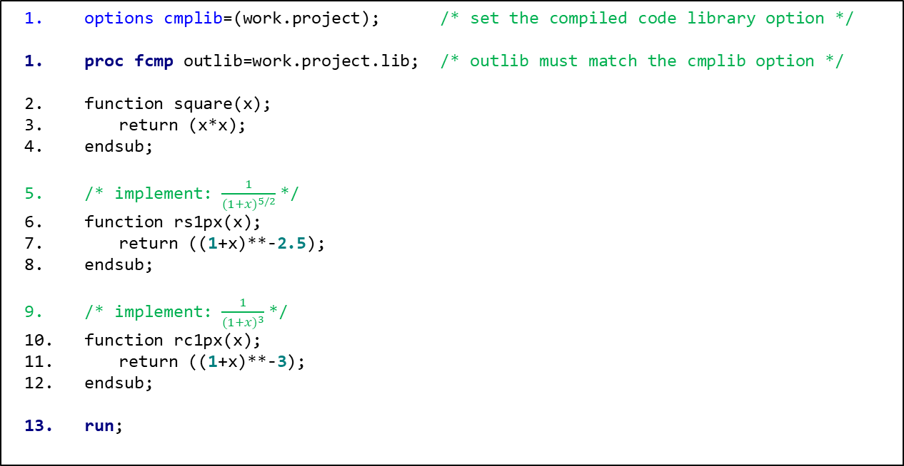
How to define your own functions…
options cmplib=(work.project); /* set the compiled code library option */
proc fcmp outlib=work.project.lib; /* outlib must match the cmplib option */
function square(x);
return (x*x);
endsub;
/* implement: $\frac{1}{{(1+x)}^{5/2}}$*/
function rs1px(x);
return ((1+x)**-2.5);
endsub;
/* implement: $\frac{1}{{(1+x)}^{3}}$*/
function rc1px(x);
return ((1+x)**-3);
endsub;
run;

